Slide 1

Cloud Computing
Certified DevOps Foundation Workshop

Slide 2
Agenda
Cloud Computing
Workshop Details
Topics Covered in Workshop
Table of contents
DevOps Foundation Certification
Registration for the Exam
Validity of Exam voucher
Certification Exam format
Other details about the Certification
Lab Readiness - Prerequisites for the Workshop

Slide 3
Cloud
What is Cloud Computing?
Following are the key details about Cloud Computing:
Cloud computing is on-demand platform of computer system resources, data storage and computing power, without direct active management by the user.
The term is generally used to describe data centers available to many users over the Internet.
Cloud computing is a method for delivering information technology (IT) services in which resources are retrieved from the Internet through web-based tools and applications, as opposed to a direct connection to a server.
to improve collaboration and productivity
by
Continuously
automating infrastructure, automating workflows
measuring application performance

Slide 4

Cloud
What is Cloud Computing?
Rather than keeping files on a proprietary hard drive or local storage device, cloud-based storage makes it possible to save them to a remote database.
The availability of high-capacity networks, low-cost computers and storage devices as well as the widespread adoption of hardware virtualization, service-oriented architecture, and autonomic and utility computing has led to growth in cloud computing.
to improve collaboration and productivity
by
Continuously
automating infrastructure, automating workflows
measuring application performance

Slide 5
Introduction to Cloud Computing
Cloud Services
A cloud service is any service made available to users on demand via the Internet from a cloud computing provider's servers as opposed to being provided from a company's own on-premises servers.
Cloud services are designed to provide easy, scalable access to applications, resources and services, and are fully managed by a cloud services provider.
A cloud service can dynamically scale to meet the needs of its users.
Notes:
Cloud services are provided by cloud providers which can be used on-demand by user. These are dynamic and scalable resources which we can easily manage using management Console.
Cloud

Slide 6
Introduction to Cloud Computing
Cloud Services
The usage of cloud services has become closely associated with common cloud offerings, such as software as a service (SaaS), platform as a service (PaaS) and infrastructure as a service (IaaS).
Examples of cloud services include online data storage and backup solutions, Web-based e-mail services, hosted office suites and document collaboration services, database processing, managed technical support services and more.
Notes:
We can scale up or down these cloud services depending on load on infrastructure. There are so many cloud providers which can provide these cloud services.
Cloud services helps IT team to easily manage infrastructure and software applications. It helps to reduce the overall infrastructure cost.

Slide 7
Introduction to Cloud Computing
Cloud Advantages
Cost Savings: The most significant cloud computing benefit is in terms of IT cost savings. Businesses, no matter what their type or size, exist to earn money while keeping capital and operational expenses to a minimum. With cloud computing, you can save substantial capital costs with zero in-house server storage and application requirements.
Reliability: With a managed service platform, cloud computing is much more reliable and consistent than in-house IT infrastructure. Most providers offer a Service Level Agreement which guarantees 24/7/365 and 99.99% availability.
Notes:
Cloud environment provides lot of advantages when implemented in organization. Below are some of the advantages listed:
Cost Savings: Cloud provides lot of benefits to IT in terms of cost savings in infrastructure. With cloud we can create cheap virtual machines which helps lot of infrastructure cost as compared to physical machines.
Reliability: Cloud environment is quiet reliable, it does not mean that cheap infrastructure comes with less reliability. Most of the infrastructure supports 99.99% uptime. Cloud provides make sure that we don’t see any downtime for our infrastructure.

Slide 8
Introduction to Cloud Computing
Cloud Advantages
Manageability: Cloud computing provides enhanced and simplified IT management and maintenance capabilities through central administration of resources, vendor managed infrastructure and SLA backed agreements. IT infrastructure updates and maintenance are eliminated, as all resources are maintained by the service provider.
Quality Control: In cloud based system, all documents and code is place in single location. Everyone accesses this information in constant manner leaving no scope for any human errors.
Notes:
Manageability: Cloud platform provides easy interfaces using which we can easily manage virtual machines and other resources. IT team gets lot of help while maintaining huge number of infrastructure components.
Quality Control: These cloud infrastructure are making sure that the quality of services is better than physical infra. Some cloud providers are providing some services which is having more performance as compared to physical resources.

Slide 9
Introduction to Cloud Computing
Cloud Disadvantages
Downtime: As cloud service providers take care of a number of clients each day, they can become overwhelmed and may even come up against technical outages. This can lead to your business processes being temporarily suspended.
Security: Although cloud service providers implement the best security standards and industry certifications, storing data and important files on external service providers always opens up risks. Using cloud-powered technologies means you need to provide your service provider with access to important business data.
Notes:
Cloud computing is also having some disadvantages as mentioned below:
Downtime: These cloud providers are supporting so many clients at same time that sometimes there might be some technical outages. This may impact your project as it may take more time to resolve these technical issues.
Security: Although these cloud providers are following lot of security practices, but there are so many vulnerabilities which posses an threat to our servers. Since its an public cloud there is huge risk in terms of hacking and attacks.

Slide 10
Introduction to Cloud Computing
Cloud Disadvantages
Limited Control: Since the cloud infrastructure is entirely owned, managed and monitored by the service provider, it transfers minimal control over to the customer. The customer can only control and manage the applications, data and services operated on top of that, not the backend infrastructure itself.
Lower Bandwidth: Many cloud storage service providers limit bandwidth usage of their users. So, in case if your organization exceeds the given quota, additional charges will be applicable for extra bandwidth.
Notes:
Limited Control: These cloud platforms are developed in such a way that we can easily manage resources over internet. Which means we can not perform any customization to these portals and we have to use these portals in same way how its configured.
Lower Bandwidth: Cloud platforms supported only some limited quota of bandwidth for network. Once applications interact with each other they use this quota and once this is over, they have to pay extra cost to cloud providers.

Slide 11
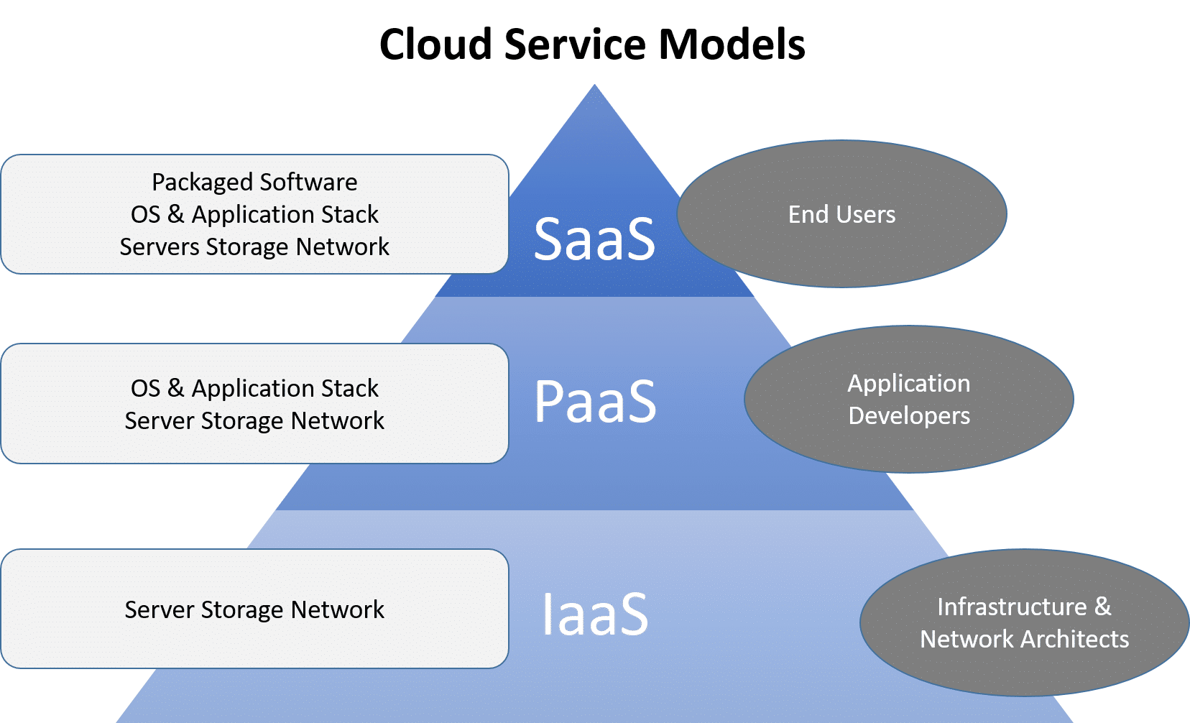
Introduction to Cloud Computing
Cloud Service Models
Cloud Computing provides various service models using which we can implement cloud computing in our organization.
Notes:
Cloud computing supports majorly three service models which provides various kind of service models.

Slide 12
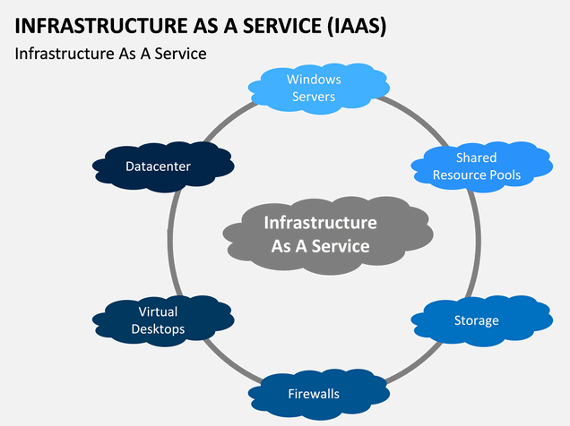
Introduction to Cloud Computing
IaaS
Infrastructure as service also commonly referred as IaaS, is a cloud service that delivers computing resources, network resources and storage resources.
These resources can be procured on-demand and on a
pay-as-you-go basis.
IaaS is an combination of both physical and virtual resources
depending on cloud providers.
With these services IT team gets lot of help in automating
administrative tasks across the vast infrastructure.
Source: sketchbubble.com
Notes:
Infrastructure as a service involves a method for delivering everything from operating systems to servers and storage through IP-based connectivity as part of an on-demand service. Clients can avoid the need to purchase software or servers, and instead procure these resources in an outsourced, on-demand service.

Slide 13
Introduction to Cloud Computing
IaaS Features
Below are some of the features of using IaaS in Cloud Computing:
Automated administrative tasks
Dynamic scaling
Platform virtualization technology
GUI and API-based access
Internet connectivity
Notes:
IaaS provides lot of features which helps us to get lot of benefits:
Automated administrative tasks
Dynamic scaling
Platform virtualization technology
GUI and API-based access
Internet connectivity

Slide 14
Introduction to Cloud Computing
IaaS
This service provides cost-efficient infrastructure which reduces huge burden in buying and managing infrastructure.
IaaS is considered as one of the basic layer in cloud computing model.
Some of the examples of IaaS service by various cloud providers are as below:
Amazon EC2
Windows Azure
Rackspace
Google Compute Engine
Notes:
IaaS can also be used in order to create infrastructure even if we don’t know how to manage infrastructure. It helps developers also to provision new infra without having any operations experience. Overall this service helps the IT team to create complete infrastructure over internet through an management portal.
Below are some of the cloud providers providing IaaS service:
Amazon EC2: AWS EC2 is one of the service provided by Amazon Cloud which helps us to create servers, IP addresses, load balancers and other resources.
Windows Azure: Azure is cloud service provided by Microsoft. Like AWS EC2, azure also helps to create virtual resources and we can manage these resources through azure portal.
Rackspace: Rackspace is not similar to AWS and Azure but its providing core infrastructure components which we can create with Rackspace.
Google Compute Engine: GCP is one of the cloud solution provided by Google. Its relatively new as compared to other clouds but its also providing some exciting infrastructure components which we can manage using GCP portal.

Slide 15
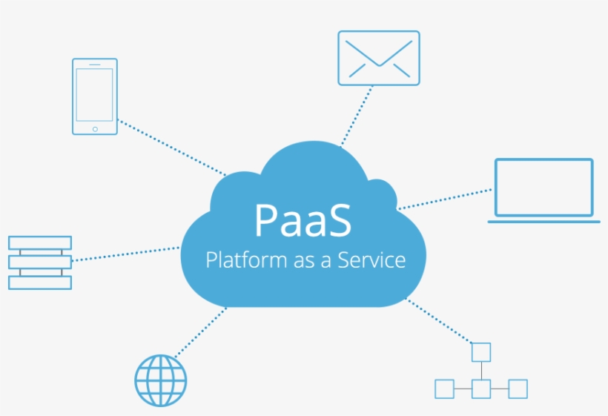
Introduction to Cloud Computing
PaaS
Platform as a service is a service in which cloud provider delivers hardware and software both, which means developers don’t have to worry about infrastructure components.
PaaS components can be easily accessible over internet
PaaS provides reliable and optimized environment on
which developers can quickly setup/deploy their apps.
With PaaS we don’t have to focus on how to creating
and managing infrastructure.
Source: nicepng.com
Notes:
Of the three layers of cloud-based computing, PaaS is considered the most complex. PaaS shares some similarities with SaaS, the primary difference being that instead of delivering software online, it is actually a platform for creating software that is delivered via the internet.

Slide 16
Introduction to Cloud Computing
PaaS Features
PaaS supports some key features which helps us to easily deploy our applications on various platforms.
Easy Development
Flexibility
Scalability, Load balancing and fail over
On demand platform
Container Based PaaS
Notes:
PaaS supports some key features which helps us to easily deploy our applications on various platforms.
Easy Development
Flexibility
Scalability, Load balancing and fail over
On demand platform
Container Based PaaS

Slide 17
Introduction to Cloud Computing
PaaS
It helps developers to design applications quickly and efficient.
PaaS is an layer on top IaaS, which means in addition to core infrastructure resources we also get middleware, databases and other development tools.
PaaS platform's are available for public, private and hybrid clouds.
Some of the cloud providers who provides PaaS services are listed below:
AWS Elastic Beanstalk
Google App Engine
Azure App Service
Pivotal Cloud Foundry
Notes:
PaaS provides an complete package to developers so that they can simply deploy their applications. They don’t have to manage the infrastructure components and this helps them to complete development fast and on time. There are so many PaaS services available but some of them are listed below:
AWS Elastic Beanstalk: With AWS EBS we don’t have to know how to create servers, with this we just have to select which platform we need and then deploy your application. With EBS we can deploy and test multiple applications at the same time.
Google App Engine: Google App Engine is one of the service in GCP where we can select which programming language code we are deploying and depending on that platform will be provisioned. We don’t have to do any steps manually with PaaS.
Azure App Service: This is one of the PaaS service provided by Azure cloud. This service manages server provisioning, load balancing, scaling and deployment of applications without any user interference.
Pivotal Cloud Foundry: Cloud foundry is an open source PaaS managed by pivotal software. With this we can deploy applications in private cloud without any security issues.

Slide 18
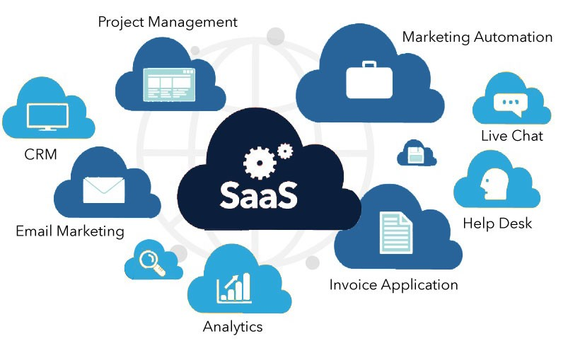
Introduction to Cloud Computing
SaaS
Software as a service is one of the service model in cloud computing in which we don't have to install any software or any application.
SaaS allows user to use the application as per usage without
buying any dedicated licenses.
User just have to access application over internet without
performing any installation or configuration.
Startups or small companies don’t have to waste time on creating infrastructure.
Source: medium.com
Notes:
SaaS is a cloud computing offering that provides users with access to a vendor’s cloud-based software. Users do not install applications on their local devices. Instead, the applications reside on a remote cloud network accessed through the web or an API. Through the application, users can store and analyze data and collaborate on projects.

Slide 19
Introduction to Cloud Computing
SaaS Features
SaaS provides lot of features using which we can share software with multiple users.
Scalability
Interoperability
Identity management
Redundancy
Configurability
Analytics
Ease of use
Notes:
SaaS provides lot of features using which we can share software with multiple users.
Scalability
Interoperability
Identity management
Redundancy
Configurability
Analytics
Ease of use

Slide 20
Introduction to Cloud Computing
SaaS
SaaS is an new layer on top of PaaS, in which we don’t even have to perform any task.
We can use these applications without any technical expertise and once our work is done we can simply discard them.
Below are some of the applications provided as SaaS:
Google GSuite (Apps)
Dropbox
Salesforce
Cisco WebEx
GoToMeeting
Notes:
SaaS helps user to directly access application over internet without performing any technical tasks. They don’t have to procure any long subscriptions, instead they can get benefit of pay-as-per-usage payment model.
Below are some of the applications with SaaS cloud Model:
Google GSuite (Apps)
Dropbox
Salesforce
Cisco WebEx
GoToMeeting

Slide 21
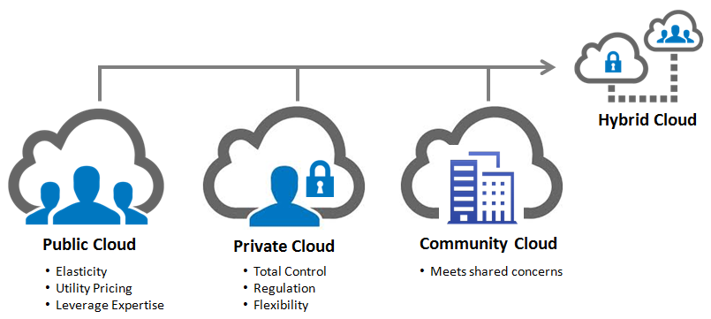
Introduction to Cloud Computing
Cloud Deployment Model
A cloud deployment model represents a specific type of cloud environment, primarily distinguished by ownership, size, and access.
There are mainly three types of cloud implementation and depending on our project we can implement any deployment model.
Public Cloud
Private Cloud
Hybrid Cloud
Notes:
Cloud deployment model is an process in which we take decision on which cloud deployment we have to use for creating our cloud infrastructure. We have mainly three types of cloud model: Public, Private and Hybrid. Selecting cloud model comes with lot of factors like cost, accessibility, reliability and much more.

Slide 22
Introduction to Cloud Computing
Public Cloud
In a public cloud deployment model, the services which are deployed are open for public use and generally public cloud services are free.
With public cloud there are some risks with security but if we implement it correctly it will provide security similar to most of private clouds.
Unlike private cloud, public cloud offers much cheaper computing resources which helps organizations to reduce expenses.
Public cloud are quiet easy to access which makes application releases faster and efficient.
Examples: AWS Cloud, Azure Cloud, Google Cloud
Notes:
Public cloud enables user to access infrastructure over internet without any restrictions. They don’t have to be there in office in order to access infrastructure. Public cloud is much cheaper than private and other cloud which helps small organizations and startup to create infrastructure and use them.

Slide 23
Introduction to Cloud Computing
Private Cloud
Private Cloud is infrastructure which is implemented and used by an single organization only.
This infrastructure can only be accessed in office premises since its not exposed over internet.
These are more expensive as compared to public cloud since we deploy this cloud on our local infrastructure.
Private provides much better security and privacy concerns as compared to public cloud.
Examples: VMware, Oracle, Dell EMC, IBM, Red Hat.
Notes:
Private cloud is cloud deployed in office premises on local infrastructure. Private cloud provides complete control on computing resources which helps us to perform any
customization to cloud.
Private cloud is implemented in those organization which feels that public cloud will not fulfill there requirements.

Slide 24
Introduction to Cloud Computing
Hybrid Cloud
Hybrid cloud is an hybrid setup of interconnected public and private cloud infrastructure.
Its an mixture of on-premises, public and third party cloud services implemented in single organization.
We can create some critical environments on private cloud and non critical environment on public cloud.
With hybrid we can get benefits of multiple cloud deployment model at once.
With hybrid cloud organizations can look up for both security and agility also. They don’t have to put much efforts in procuring physical infrastructure.
Notes:
Hybrid cloud allows to interoperate applications across different clouds in an organization. In case we have to create some temporary projects we can easily create it in private cloud which helps to keep expenses in control.

Slide 25
Introduction to Cloud Computing
Cloud Providers
Cloud providers are the vendors who deals in cloud computing.
These cloud providers are providing various cloud services like IaaS, PaaS, SaaS.
Cloud provides various automations which helps us to create reliable, cheap and flexible infrastructure.
Below are some of the reliable cloud providers which provides cloud computing.
Amazon Web Services (AWS)
Microsoft Azure
Google Cloud Platform
OpenStack Cloud
Digital Ocean Cloud
Notes:
Hybrid cloud allows to interoperate applications across different clouds in an organization. In case we have to create some temporary projects we can easily create it in private cloud which helps to keep expenses in control.

Slide 26
Introduction to Cloud Computing
Amazon Web Services(AWS)
AWS is a subsidiary of Amazon that provides flexible, reliable, scalable and cost effective cloud computing solutions.
AWS provides various cloud services like IaaS, PaaS, SaaS which helps organizations to reduce there efforts in managing infrastructure components.
AWS was first launched in 2006 and still is one of the leader in cloud computing solutions.
Using AWS we can create compute resources, storage resources, network resources, databases, load balancers, domain name and lot more.
AWS offers right now more than 100 cloud services to its user.
Notes:
AWS is one of the cloud product launched by Amazon in year 2006. It provides a variety of cloud services which we can use to implement DevOps in our organization. We can create almost every infrastructure component in AWS. AWS offers pay-as-per-usage model which helps IT team to minimize infra expenses.

Slide 27
Introduction to Cloud Computing
Microsoft Azure
Azure is an cloud platform provided by Microsoft for creating infrastructure on Microsoft-based data centers.
Azure was initially announced in 2008 but officially it was released in 2010 as Windows Azure.
Initially azure was not that much popular as compared to well established clouds like AWS. But around 2014 it was rebranded as Microsoft Azure which helps azure to gain popularity.
Azure provides lot of CI/CD services which is used to automate DevOps implementations in organization.
Notes:
Azure is an cloud platform provided by Microsoft for creating infrastructure on Microsoft-based data centers.
Azure was initially announced in 2008 but officially it was released in 2010 as Windows Azure.
Initially azure was not that much popular as compared to well established clouds like AWS. But around 2014 it was rebranded as Microsoft Azure which helps azure to gain popularity.
Azure provides lot of CI/CD services which is used to automate DevOps implementations in organization.

Slide 28
Introduction to Cloud Computing
Google Cloud
Google cloud platform is one of the leading Cloud Computing services which are offered by Google and it runs on the same infrastructure that Google uses for its end-user products.
The Google cloud platform is basically used for Google search and YouTube.
Google Cloud was announced in 2008 for deploying applications in google-managed infrastructure.
There are various services offered by Google Cloud such as data analysis, machine learning, and data storage.
As of 2019, Google Cloud Platform is available in 20 regions and 61 zones.
Notes:
Google Cloud is cloud offering provided by google. Although there are other cloud providers also but we have seen some increase in GCP implementations. Its providing almost all services equivalent to other clouds like AWS and Azure. GCP supports machine learning and other latest technologies services which helps developer to develop next gen applications.

Slide 29
Introduction to Cloud Computing
Open Stack Cloud
OpenStack is a free and open-source software platform for cloud computing, mostly implemented to avail infrastructure-as-a-service (IaaS) using which we can create computing resources.
Open stack initially began in 2010 as joint project of Rackspace and NASA to develop this open source cloud platform.
Open stack helps users to deploy virtual machines and other resources which can be used to deploy applications.
Since its not owned by single organization, sometimes it becomes difficult to get information regarding open stack.
Notes:
Open Stack is cloud platform used to implement IaaS cloud service in your organization. Using this we can get benefit of both public and private cloud.
Open stack is an solution which helps us to design an cloud environment using virtualization and open stack scripts.

Slide 30
Introduction to Cloud Computing
Digital Ocean Cloud
Digital ocean like other clouds provides cloud solutions to developers so that they can quickly deploy applications.
Launched in 2011, digital ocean has currently 9 data centers across globe.
Digital ocean cloud offerings is one of the cheapest offerings which we have as compared to other clouds.
As compared to AWS, digital ocean does not provide resources like load balancers, databases and configuration management.
Digital ocean can be managed using a web interface or using doctl command line.
Notes:
Digital ocean like other clouds provides cloud solutions to developers so that they can quickly deploy applications.
Launched in 2011, digital ocean has currently 9 data centers across globe.
Digital ocean cloud offerings is one of the cheapest offerings which we have as compared to other clouds.
As compared to AWS, digital ocean does not provide resources like load balancers, databases and configuration management.
Digital ocean can be managed using a web interface or using doctl command line.

Slide 31
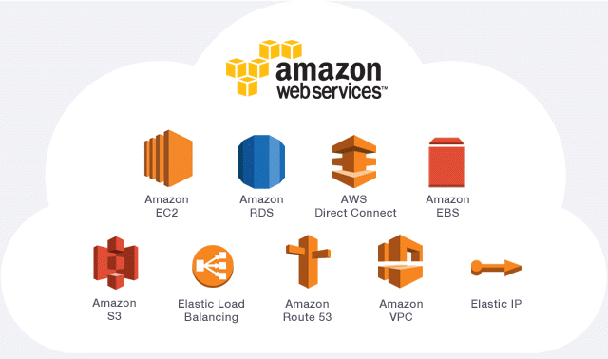
AWS Services

Slide 32
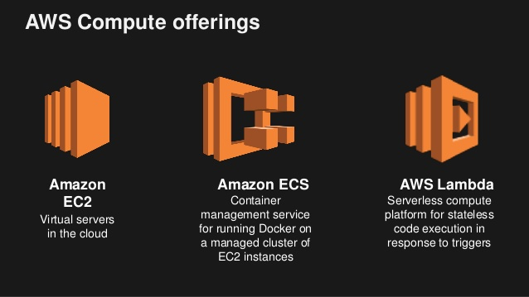
AWS Compute Services

Slide 33
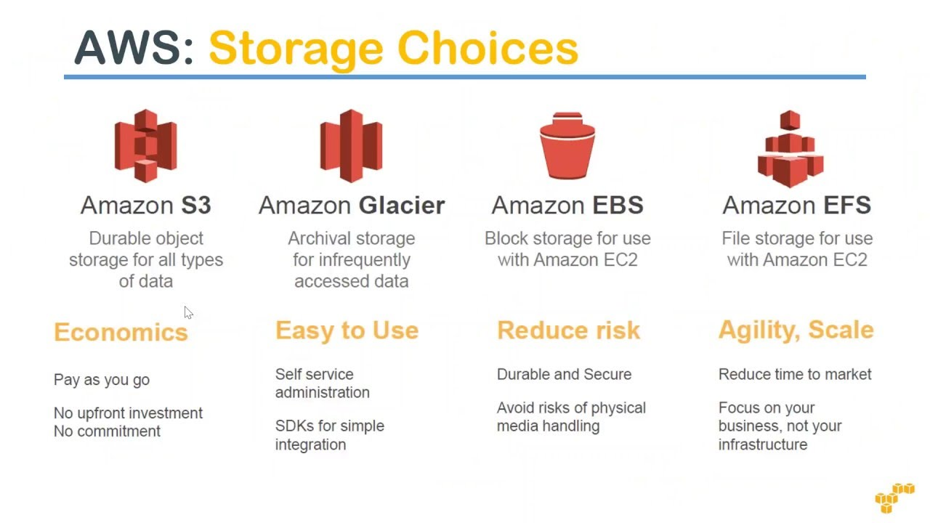
AWS Storage Services

Slide 34
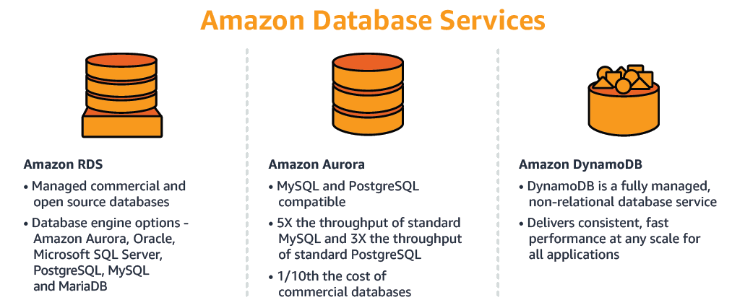
AWS Database Services

Slide 35

THANK
YOU

